Slide 1
Applied Software Security
Lecture 2
Memory

Slide 2
Memory and runtime - preface
We’ve talked about how the cpu fetches and executes instructions from the memory and how these instructions can be used to manipulate the memory.
With that we’ve talked about how every byte in the memory has an address.
If all programs shared the same memory, we would run into several problems:
Each program would only be able to use a small portion of the memory, and two programs cannot hold different data / code in the same address.
Different programs would be able to, intentionally or unintentionally, access each other’s data and mess up each other’s states.
Both of the above with the system code as well.
These problems are solved with (among other things) virtual memory and the memory management unit (MMU).

Slide 3
Virtual Memory
Each process gets it’s own execution context with
a logical address space:
Each program’s code will have “the entire memory for itself”.
The cpu will use the memory as we have seen before, but the actual memory accesses would undergo translation via a designated hardware component, and bookkeeping of the operating system.
This way the fact that the programs are running on the same machine would be (virtually*) transparent to them, and each program will be isolated in it’s “own memory space”.
We will take this as a fact for now (and return to it in a few slides), so we can talk a little about how an execution context of a program looks.
* More on that later on.

Slide 4
Execution environment
The basic execution unit in linux systems are processes or tasks.
A linux process has it’s execution context (memory and registers), and set of operating system resources (e.g. file table, signal handlers, filesystem ….)*.
This means that at any given time, each processor (core) can only execute a single task.
The os will let tasks execute (“giving them execution time”), and switch between them (aka perform a context switch) under certain conditions.
Some common conditions include: the (running) task “running for while”, the task entering a state in which it is waiting for some resource / event to occur, the task requesting an operation that requires a context switch, interrupts (later on).
* Tasks can share a part of their context and resources with other tasks, such as their address space (memory).
This is the way in which the more common notion of process and threads is implemented: that is threads in a process are tasks which share their address space, file table, signal handlers and filesystem.

Slide 5
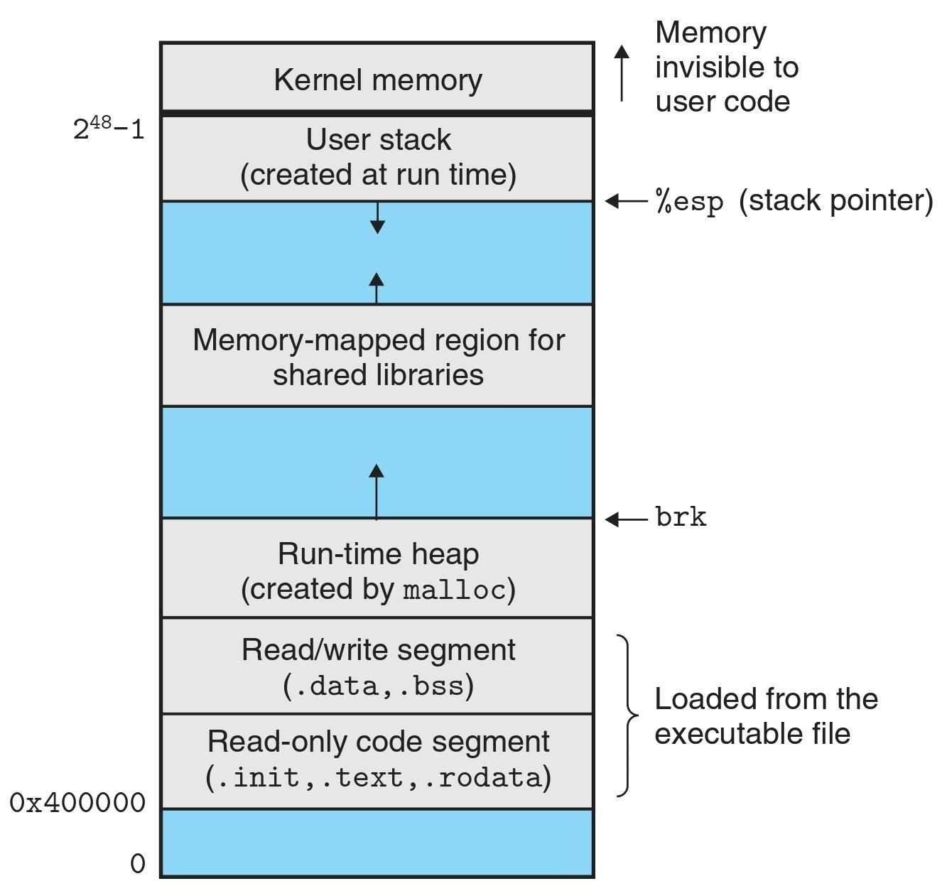
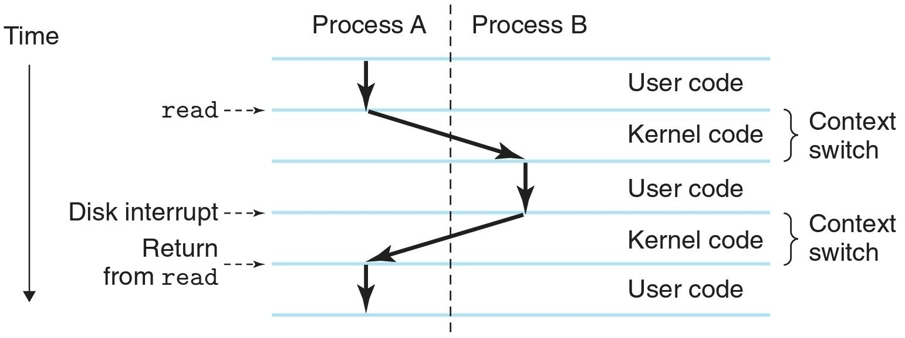
Typical memory layout of a linux x86-64 process:
Computer Systems. A Programmer’s Perspective [3rd ed.]
Context switch:

Slide 6
When running a program, the os will create a task with programs code (executable ELF) loaded into the memory, along with other code it links with dynamically (shared objects)*.
The system will initialize the task’s context such that the execution will begin at the program’s (interpreter) entry point, and schedule it for execution (that is - consider it a running process that should get execution time).
* This is done by loading the dynamic linker and executing it with the executable as a parameter.

Slide 7
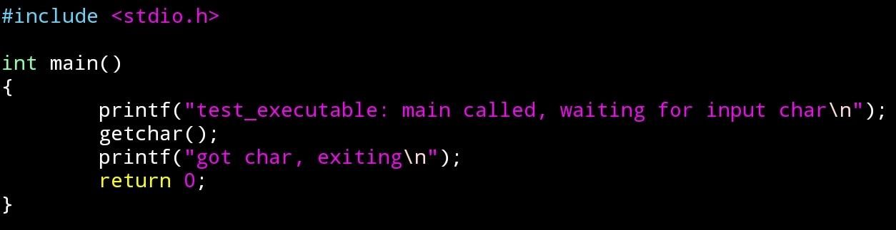
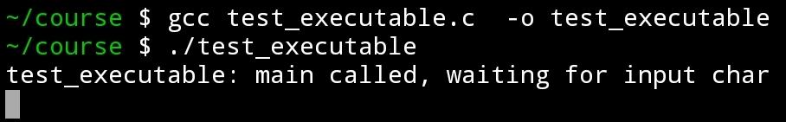
Let us look at the memory of a simple executable:

Slide 8

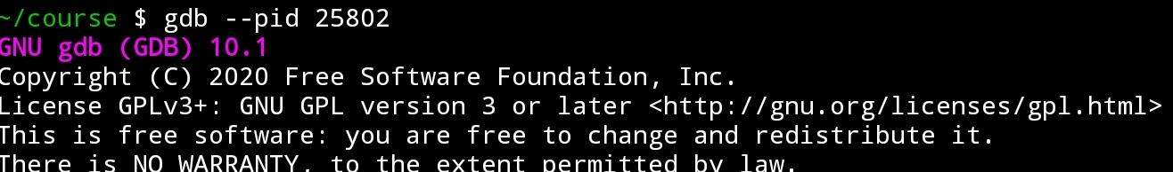
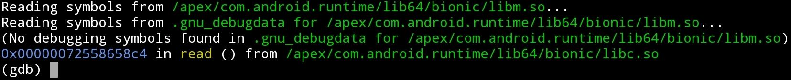
….

Slide 9
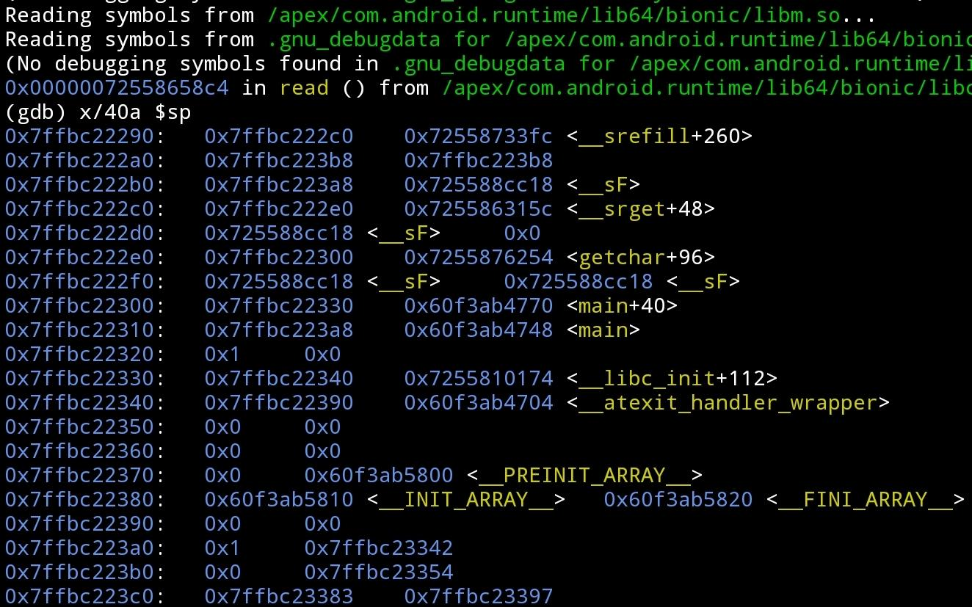

Slide 11
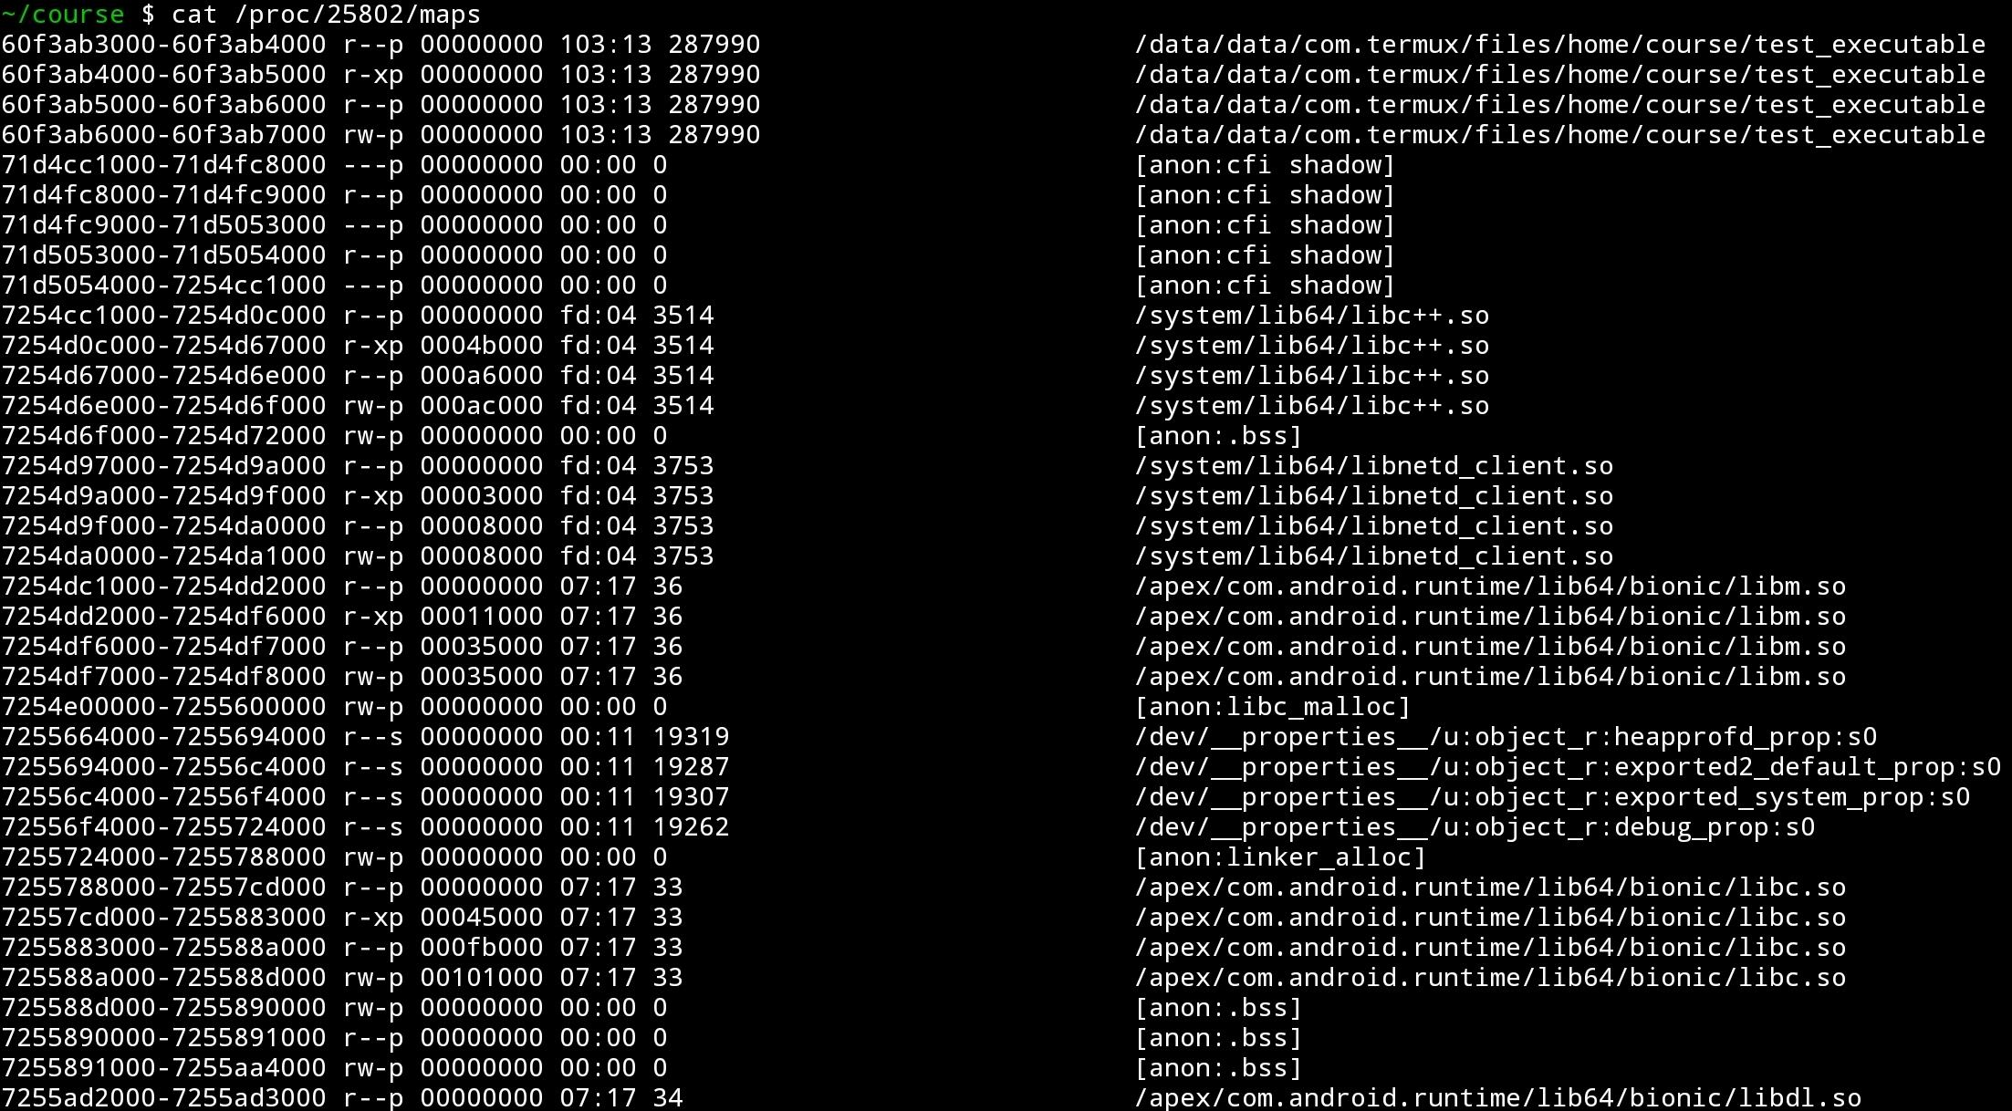

Slide 13
Mapped segments of “main” executable
Mapped segs of libc++.so shared executable
Shared mappings
Various “anonymous” mappings
Mapped segs of libc.so shared object

Slide 14
(Back to) Physical vs Virtual memory
We return to the implementation virtual memory:
That is, enabling several tasks to run with their own “virtual” memory (“address space”).
It is done in the following way:
When code is running in the context of a task, the cpu will not access the physical memory directly.
Instead references to the memory will be considered as references to the task’s virtual memory, and pass through the MMU (memory management unit - a designated hardware component).
The MMU will translate the virtual address into a physical address in the actual memory, to which the access (read / write) would be done.

Slide 15
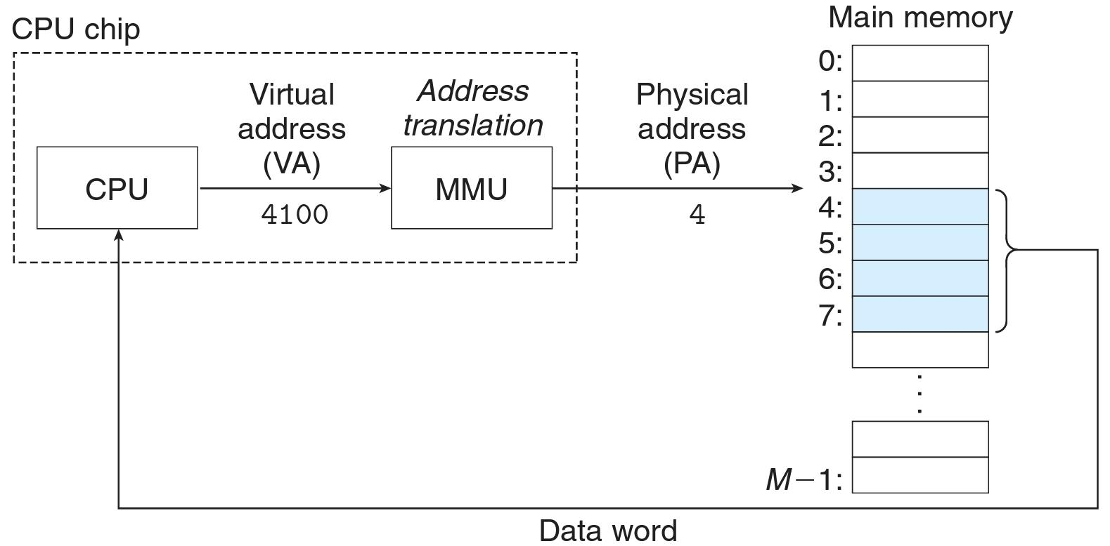

Slide 16
Physical vs Virtual memory
This “translation” process is implemented using pages, page frames, page tables and dynamic address translation:
The physical memory of the machine is divided into frames: fixed size blocks of physical memory, usually of size 4KB (0x1000 bytes). Each frame is identified by a Page Frame Number (PFN).
The virtual (logical) memory of each task is divided into pages: fixed size blocks of logical memory, usually of size 4KB. Each page is identified by a page number.

Slide 17
Virtual memory
Process A
Physical Memory (PFNs)
Virtual memory
Process B
Virtual Address
Physical
Address
Virtual Address
0
0
1
2
3
4
5
6
….
0
1
2
3
4
5
6
….
0
1
2
3
4
5
6
….
0
0
1000
1000
1000
2000
.
.
.
.
2000
.
.
.
.
2000
.
.
.
.

Slide 18
Physical vs Virtual memory
The MMU “maps” pages to PFNs.
When access is made to the memory at a virtual address x, the MMU:
Determines the page number of the page in which this address resides.
Determines the PFN of the frame that contains / should contain * the data of this page in the task’s virtual address space.
Preforms the access to the bytes corresponding to the bytes at the virtual address, in the physical memory **.
* This is done using a “query” to OS code, as we will explain.
** Additional permission access checks are done, as we will explain.

Slide 19
Virtual memory
Process A
Physical Memory (PFNs)
Virtual memory
Process B
0
1
2
3
4
5
6
….
unused
Page 4 of A
Page 4 of B
Page 1 of A
Page 5 of B
unused
Page 1 of B
….
0
1
2
3
4
5
6
….

Slide 20
Physical vs Virtual memory
The mapping process is done using a structure called Page Tables:
For each page in the virtual address space of a task, there corresponds a page table entry (PTE). This entry contains information about:
The location of the content of the page - in the physical memory as we have seen, or in the mass storage*.
The premission / privilege - is it accessable to the user / kernel (OS) / other*.
The protection of the page - can code be executed from it, can it be read from / written to*.
Has the page been written to*.
Should the page be cached*.
and more….
* Soon

Slide 21
Physical vs Virtual memory
When accessing a virtual address, the MMU uses the upper
(bits_of_address_type - bits_of_page_offset) = (theoretically*) 64-12=58 bits of the virtual address as an index to (one or more) tables of PTEs, and retrieves the physical address from the appropriate entry:
* In practice, in x86-64 only 48 bits of the address is used (the highest 16 bits are all the same if I remember correctly).

Slide 22
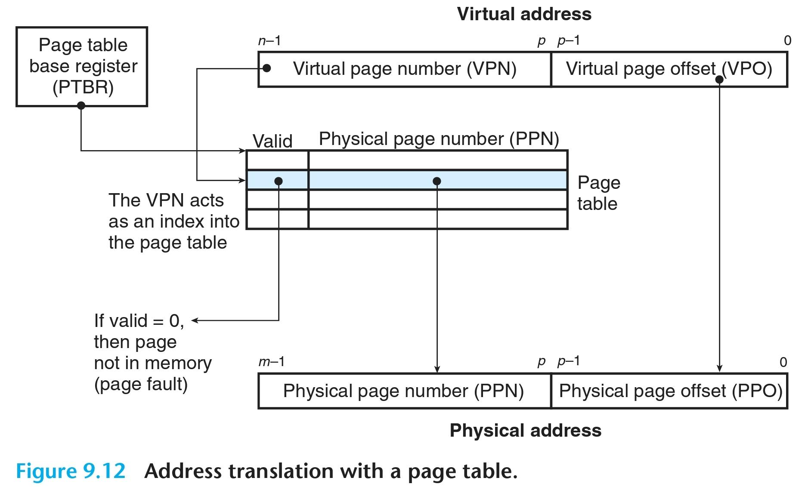

Slide 23
Completing the picture - Paging
The mechanism, as described thus far, should raise some concern:
Regardless of the translation implementation, if we have X memory and N tasks each using X/N+1 bytes of memory, we have a problem. That is our illusion of an entire address space for each task will be exposed.
We would like each task to be able to use a lot of memory.
The solution to this problem, which uses a complementary feature of the MMU called paging, essentially uses (more or less) the following fact:
Any code running on the machine access only a small portion of the memory at any given point*.
* Randal E. Bryant, David R. O’Hallaron - Computer Systems. A Programmer’s Perspective [3rd ed.], sectino 9.3.6.

Slide 24
Paging
Only some of the pages of each task would be present in the physical memory at a given time.
The rest of the memory, if used, would be stored at a special section of a mass storage device, referred to as a page file, managed and maintained by the OS.
When a page which is not resident in the physical memory is accessed by a task, the MMU will trigger a page fault, calling the OS code to load * it into the memory, and then completes the access.
This is implemented in the following way:
* Or do whatever needs to be done in this case

Slide 25
Paging
As noted before, the PTE of a page will contain a bit indicating whether or not the data of the page it describes is resident in the physical memory (aka “present” \ “paged in”) or not (aka “paged out”).
If the page is present, the access is done as described before.
If not, the MMU would trigger a fault*, which would result in a special function in the OS code, called the page fault handler, being called.
The handler will load the content of the page from the disk to the memory, and signal the MMU that it may continue the access.
If the physical memory is full, the OS can transfer the content of the memory of a (possibly different) task to the mass storage (aka “page out” a page), and replace it with the content of the requested page.
* More on faults later on.

Slide 26
Paging
When the OS initializes the context of a task, when more “mapped” memory in a task’s virtual memory is requested*, and or when it decides to transfer pages containing data from a task’s virtual memory, from the memory to the disk (say as described above), it uses the data of the PTE corresponding to the page in the task’s page table to record to itself the status of the non present page - if it is in the page file, or even not allocated yet (hasn’t been referenced yet*).
A PTE would therefore has the following format:
* more on this later.

Slide 27
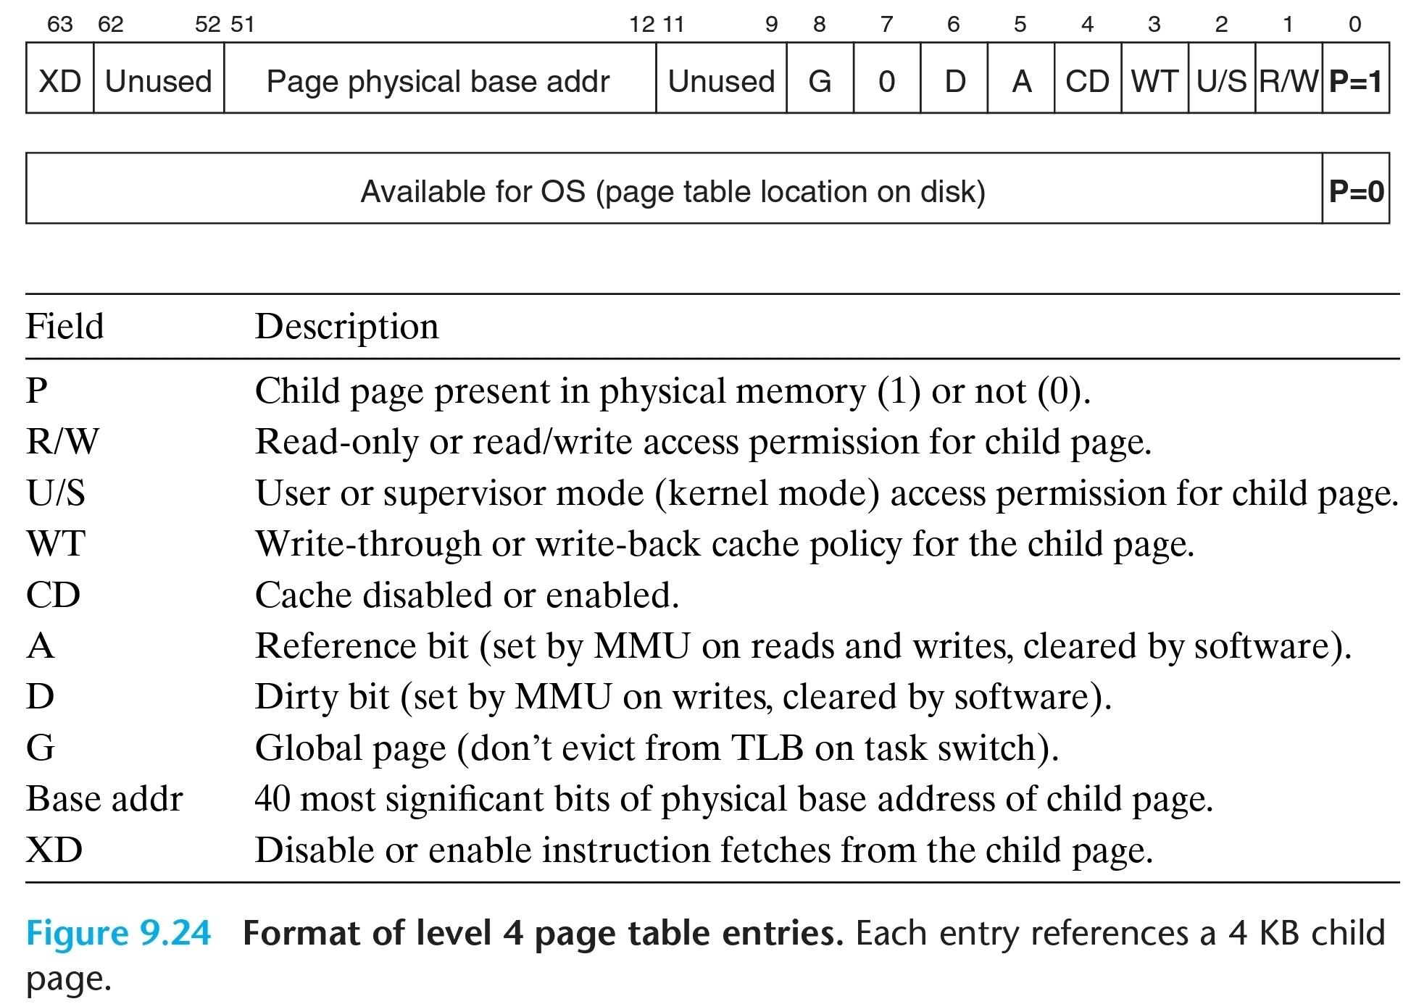

Slide 28
Back to Virtual Memory
A few calculations:
each PTE is 64 bits = 8 bytes and maps 1 page of virtual memory.
Each address space is say 4GB = 2³², and each page is say 4096 = 2¹² bytes.
This means to map a single address space with PTEs requires 2³²/2¹²=2²⁰ PTEs, or 2²⁰*2³=2²³ bytes.
This means the physical memory can hold at once the PTEs of 2³²/2²³=2048 address spaces, and this also theoretically only if non of the memory is actually used for anything else.
This can be managed with, but as we have mentioned before, each task accesses only a small portion of the memory at a given time.
This means also only a small portion of PTEs are used for a task at a given time.
Why not page out the unused PTEs?

Slide 29
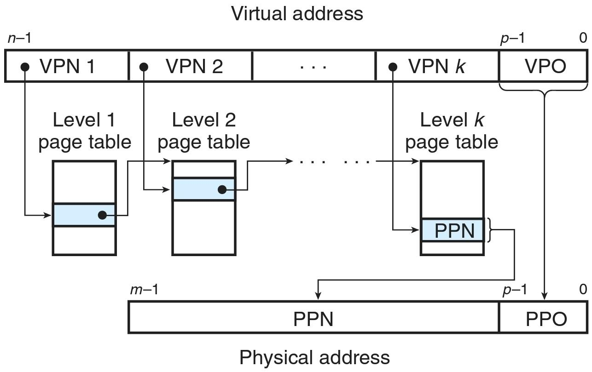

Slide 30
Multi-level Page Tables
Instead of splitting the virtual address to an index into a table of PTEs and an offset into a page, the virtual address is split into multiple indices into several tables of different “levels”.
The physical address of the first level table is stored in a register which is maintained by the OS and changed according to the address space of the currently running task.
The translation process is done in several steps.
In each step the index into the table of the current level, indexes the PTE of the table of the next level. The table of the last level contains the PTE of the page that is translated.
In Linux on Intel x86-64 bit, there are 4 levels:

Slide 31
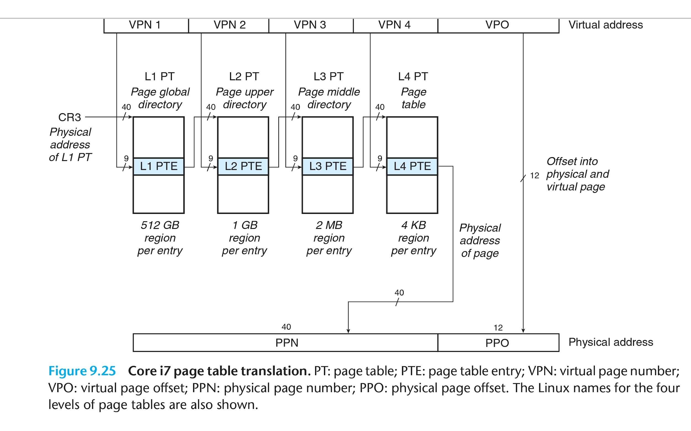

Slide 32
Multi-level Page Tables
This turns the virtual to physical address translation to a slower process, but lowers the total size of the (memory resident) metadata required for the process to a theoretically constant size of ~4 pages, and the size of metadata required in the memory for a non running task to < 1 page.
To sum it up, the multi-level page tables map the virtual address space of a task in the following way:

Slide 33
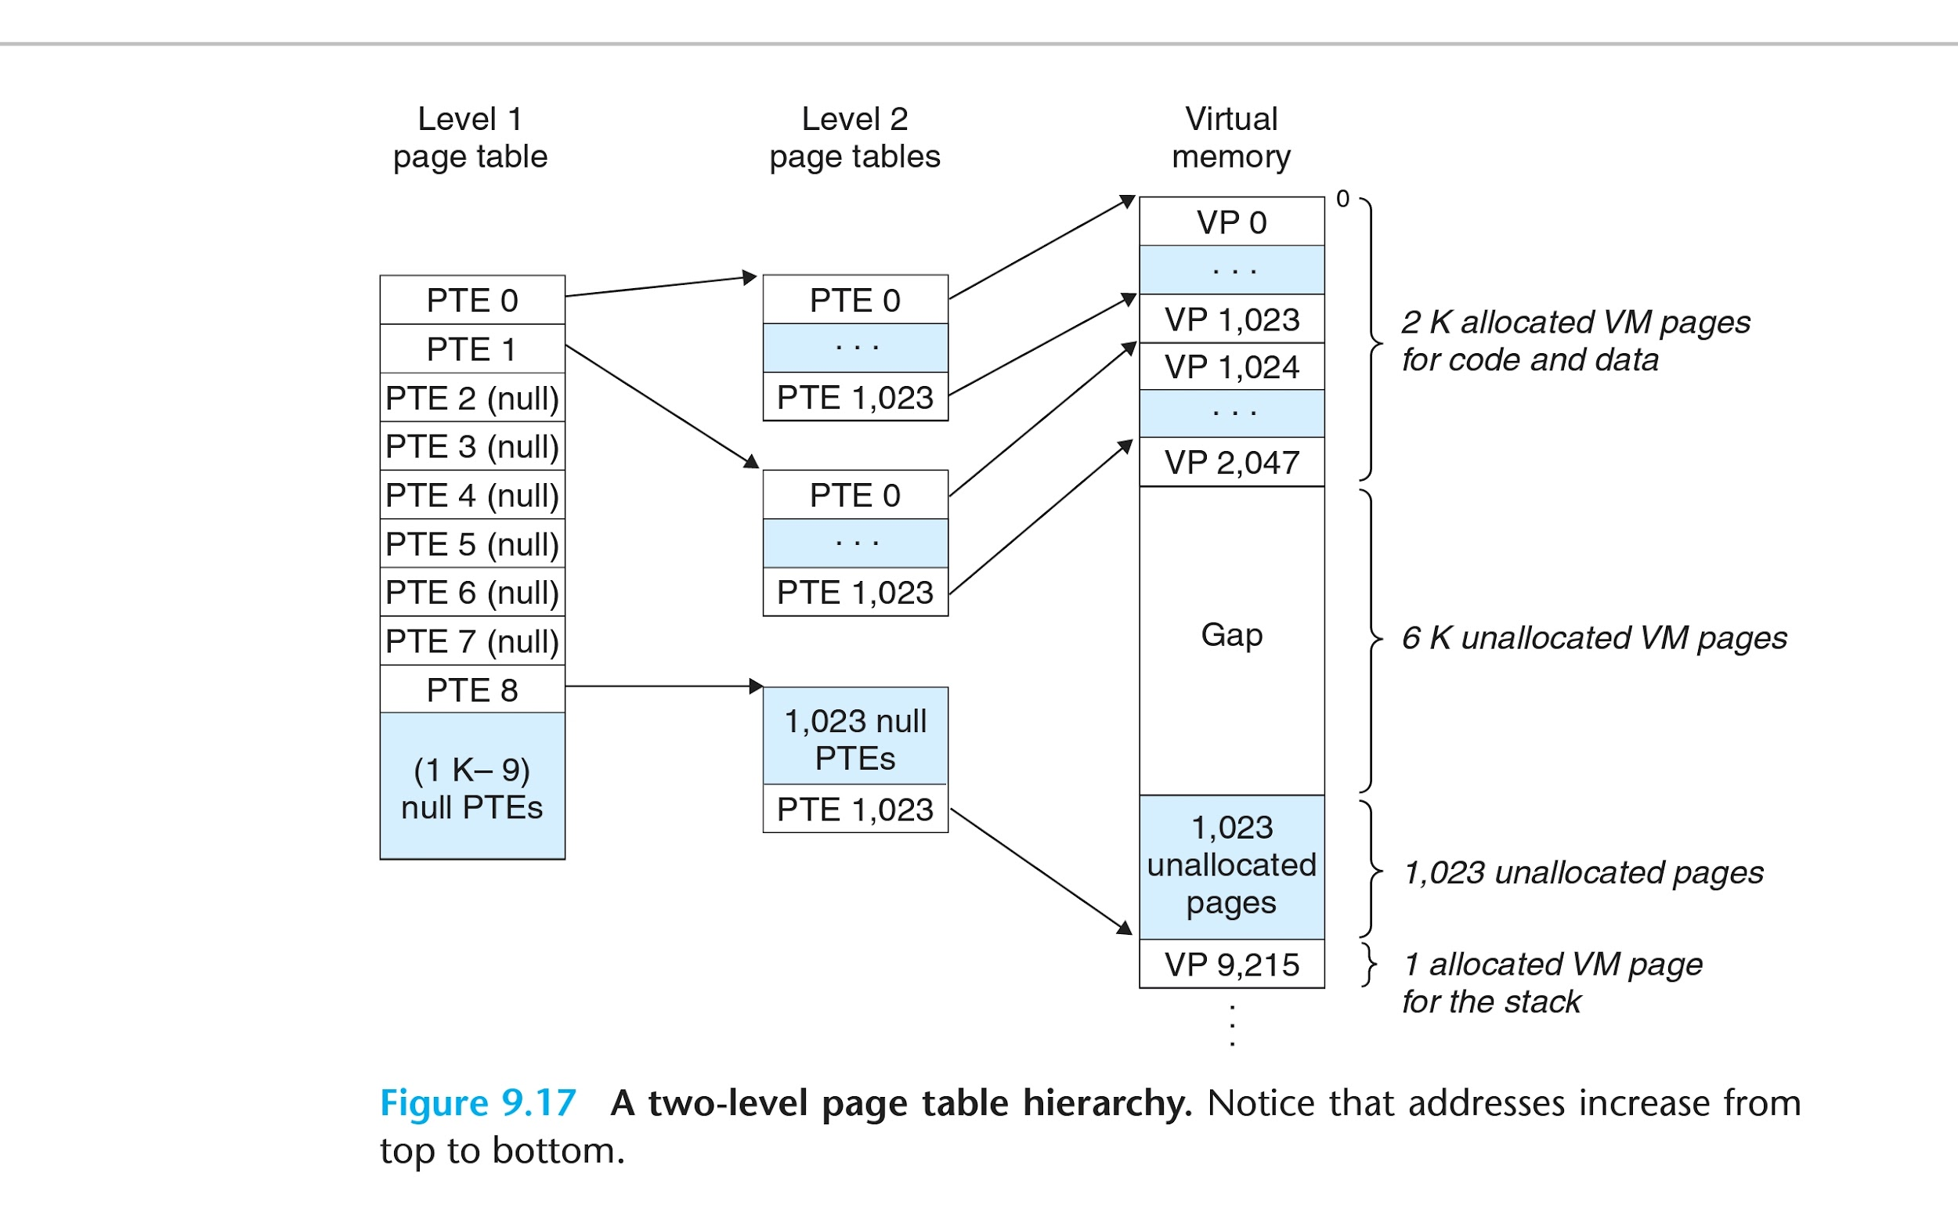

Slide 34
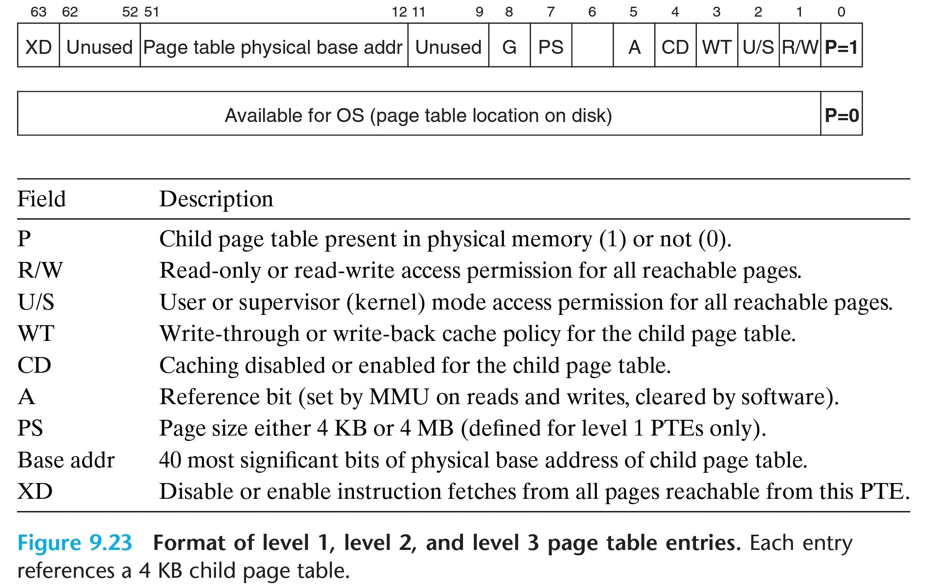
Multi-level Page Tables
The format of PTE of the first level tables and the last level tables is slightly different. The one we’ve shown before is actually of a last level table. The formats:

Slide 35
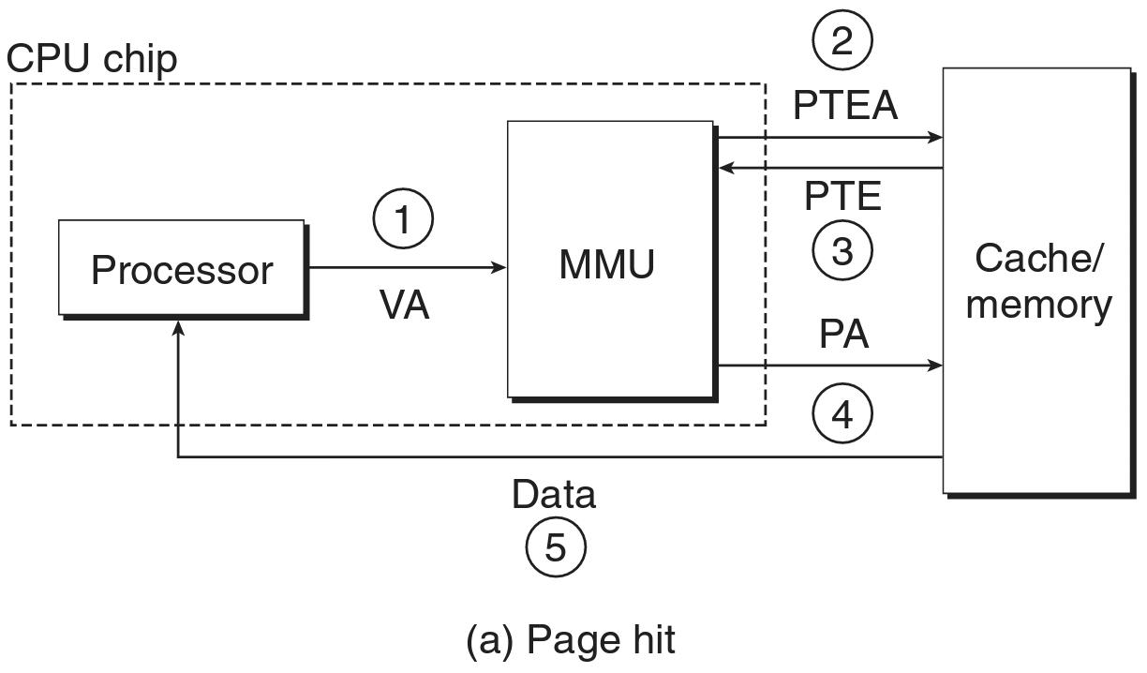
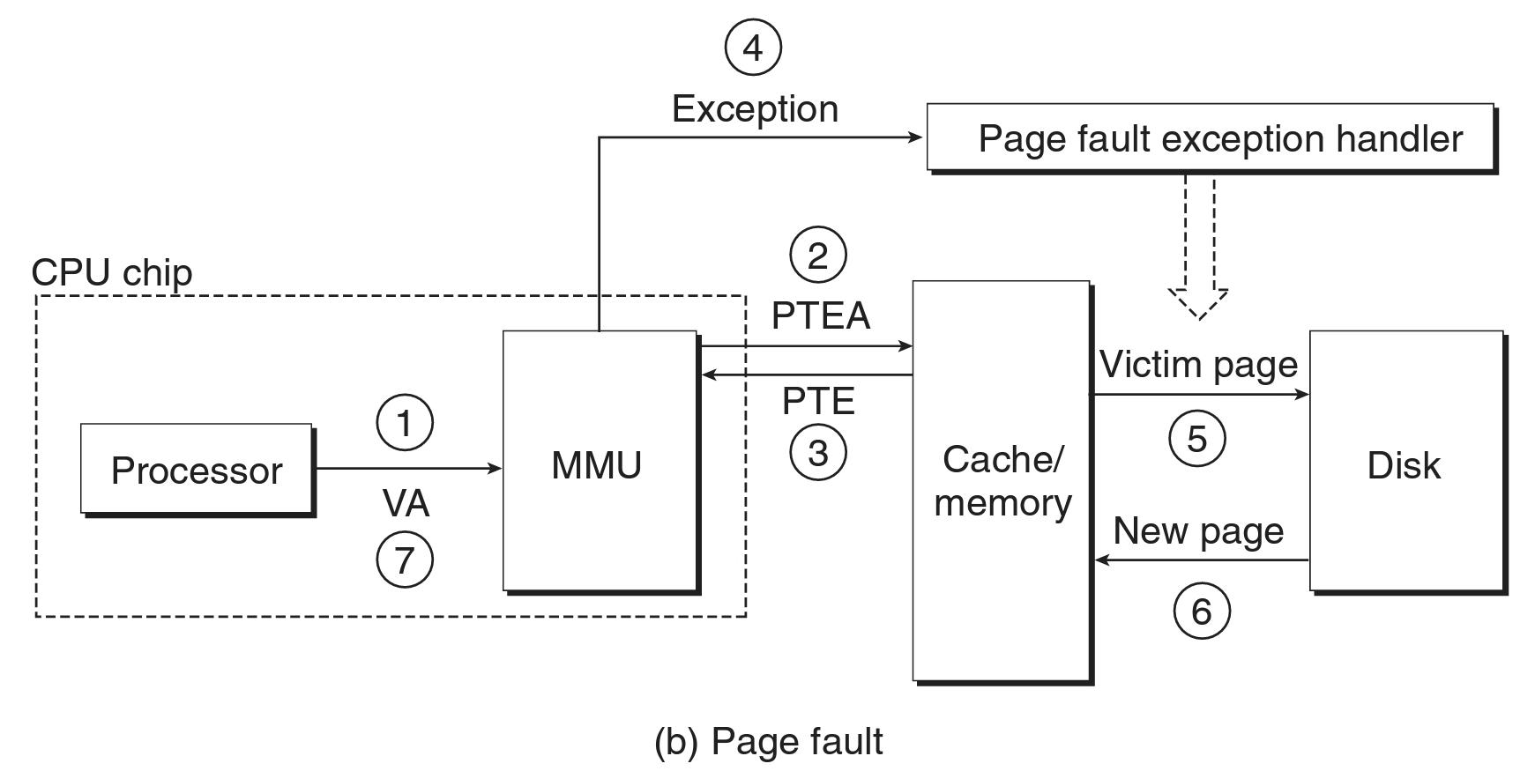
Physical and Virtual memory
So that is how virtual addresses are mapped to physical ones…. Well not quite.
Illustration of ~ the process so far:

Slide 36
Physical and Virtual memory
Translation Lookaside Buffer (TLB):
For k+1 multi-level page tables, k more times of the steps 2 and 3, combined if some of the tables are present and some aren’t.
A cache for PTEs
Used to speed up translations of virtual addresses to physical addresses.
Is indexed using the virtual address, in case of a hit spares all rounds of steps 2 and 3, in case of a miss, all rounds are needed.
Illustrations (overview, in the case of a miss as mentioned in a multi-level page table translation several of steps 3 and (a variation that does not query) the TLB of) 4 would probably be required, that is the illustration might be a bit misleading in the multi-level case):

Slide 37
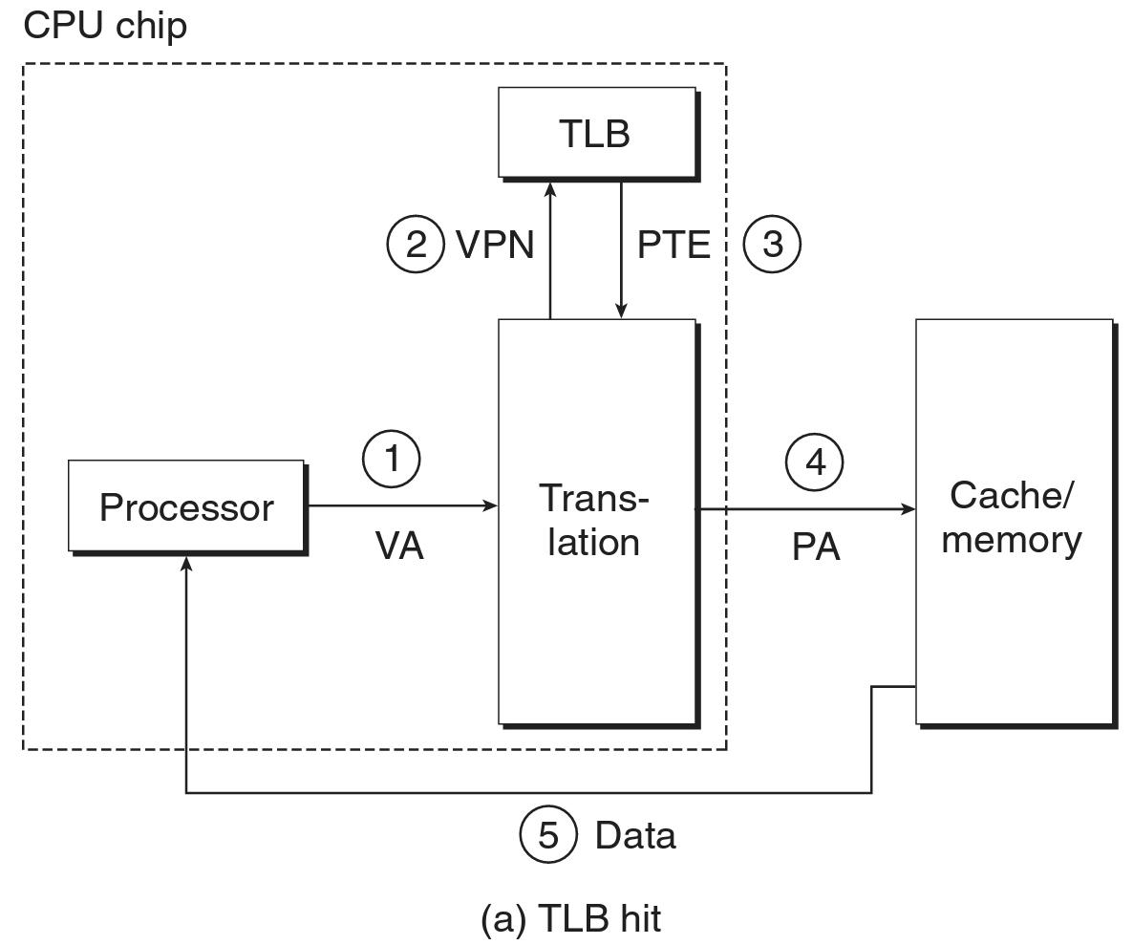
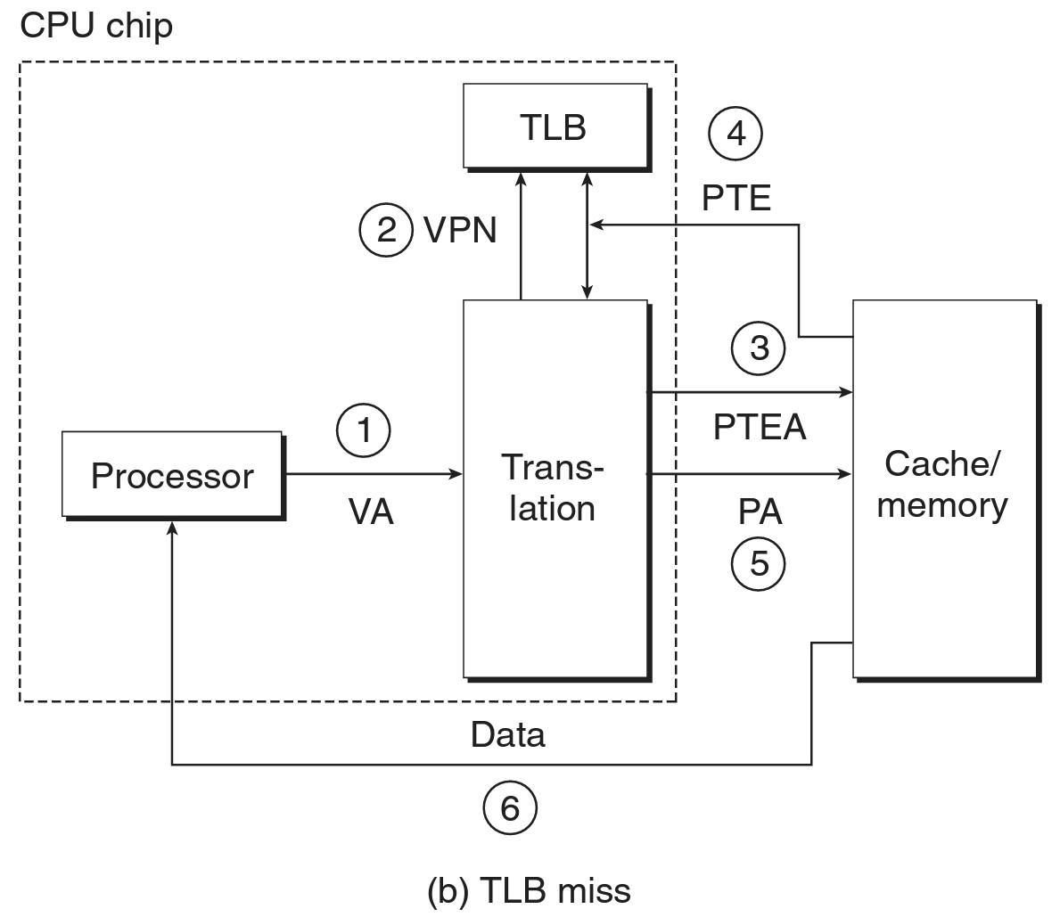

Slide 38
Physical and Virtual memory
Physical addressed caches:
Caches for actual data.
Used to speed up access to data in memory, access is faster than memory access.
Indexed using the physical address, in case of a hit spares accessing the actual memory.
Can be used to cache (among other things) PTEs and page tables.
Sometimes divided to different levels (L(i)) depending on speeds and sizes.
Sometime cpu (core) specific and sometimes shared.
Sometimes divided into instruction and data caches.
An illustration (not including the TLB, for a k+1 multi-level page table translation there are (probably) k more rounds of PTEA->PTE->):

Slide 39
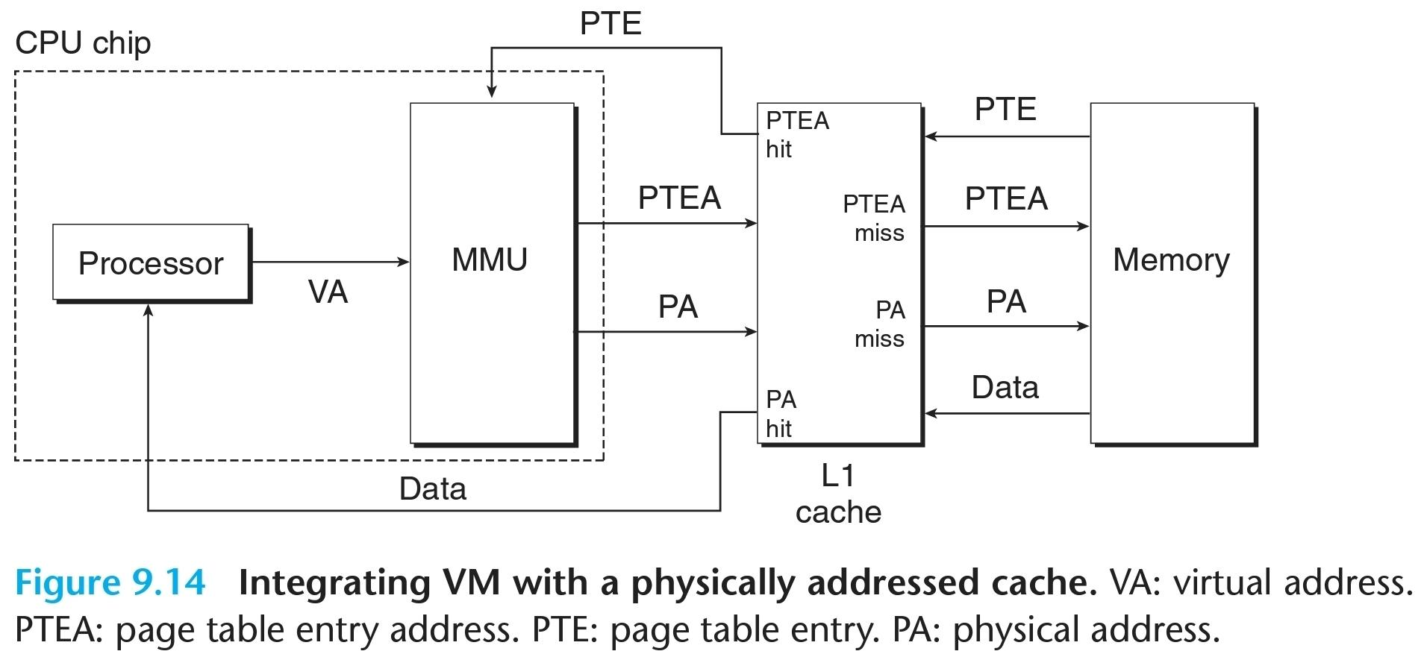

Slide 40
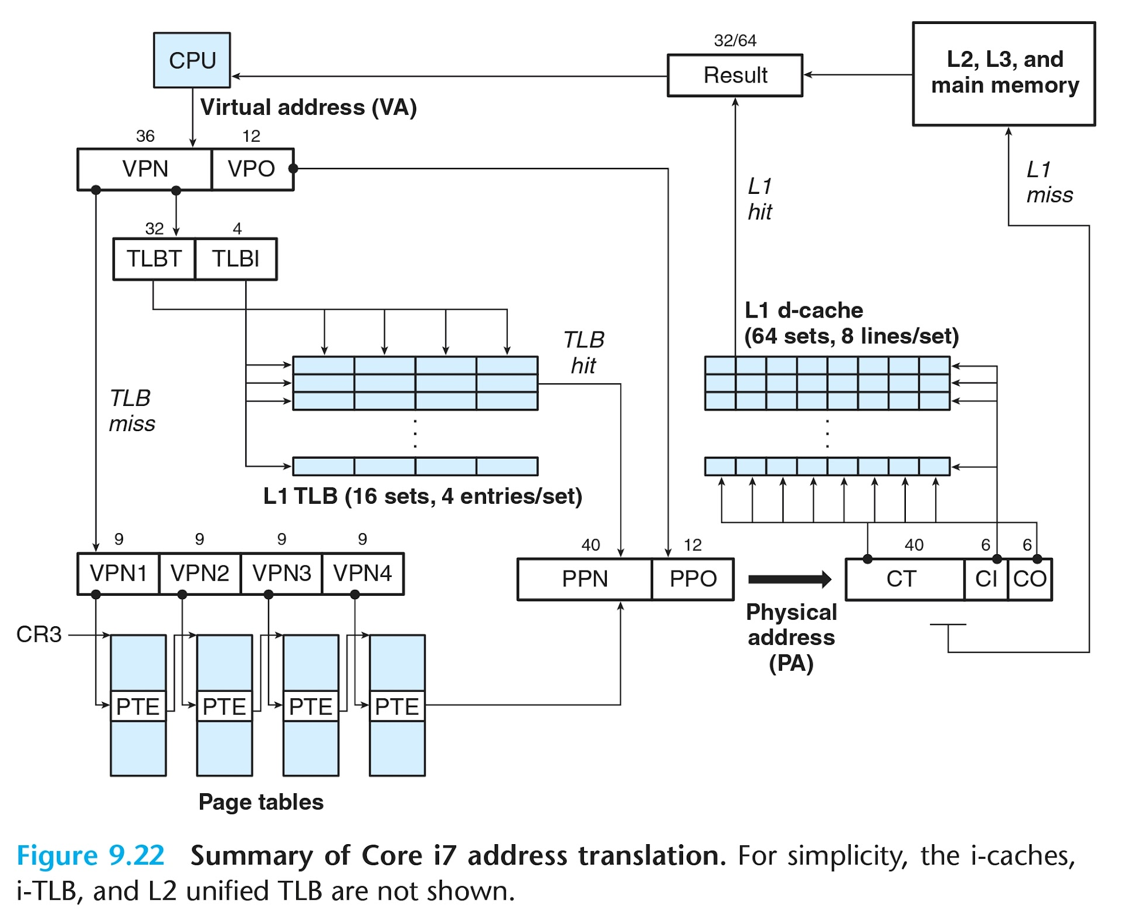
Physical and Virtual memory
Summing it up:

Slide 41
Physical and Virtual memory - final notes
We did not (and will not as of now) discuss how the kernel manages the page tables: The OS (kernel) (can use physical addressing by “disabling” the MMU but in fact) uses virtual addresses. This means that the physical pages containing different page tables need to be mapped to the virtual address space of “the task running the kernel code”.
Also, we have not discussed shared memory - what happens if two pages in (possibly different) tasks contain the same data (say that it is even readonly), for example the code of a very common shared library?
We can use the same page frame in the physical memory, and have both ptes map to this frame.

Slide 42
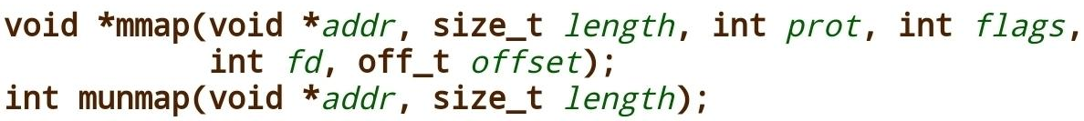
More on a task (process) memory
We have seen how the operating system can manage a tasks virtual address space.
In practice, only some pages in a tasks virtual address space are actually mapped in the memory or in the disk. This is, among other things, as not every process uses all of it’s virtual memory, and storing an entire unused address space for a process that does not use most of it is kind of redundant.
For this reason modern OSs offer tasks an api with which they can ask* to map/free memory into/from their address space.
In linux, this can be done via the mmap/munmap syscalls**:
* In fact “requires them to be polite”. ** We will expand on system calls in the following lecture.

Slide 43
More on a task (process) memory
The mmap syscall requests from the OS a memory region of a specified size (which is rounded up to a page size) at a given address.
It can be used to map the data of a file using a file descriptor*.
The munmap syscall requests the OS to free a certain number of pages at an address.
* More on file descriptors later on.

Slide 44
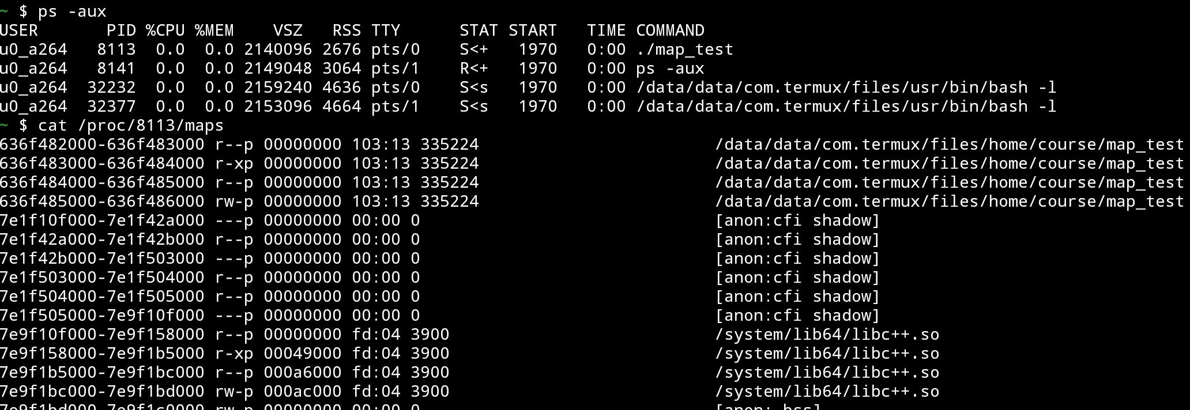
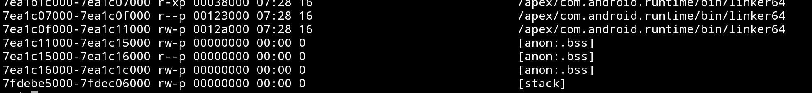
….

Slide 45
….
Some free pages

Slide 46
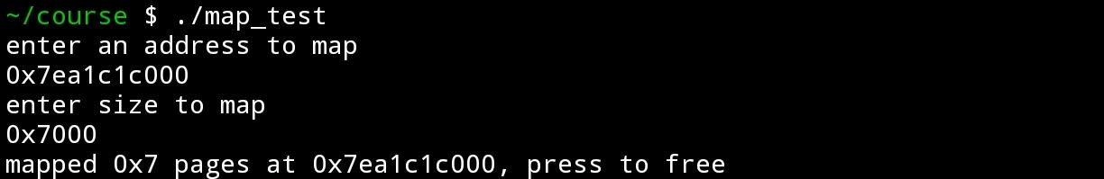

Slide 47
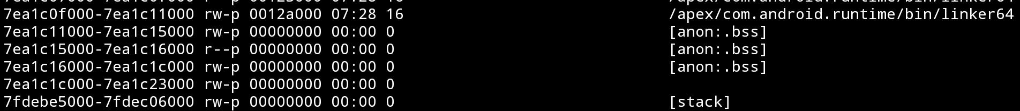
Less free pages

Slide 48
Unmapped memory - Page faults
When access is made to an unmapped page, the MMU generates a page fault, which calls the OS’s page fault handler code:
If the system recognizes that this page can be used (is valid - was mapped in the tasks space by the task code or system code), it either swaps it in from the disk if it already existed, or initializes it (with 0s) and maps it via the page tables.
If the page was not allocated, the OS assumes (almost always correctly) that this is due to a bug in the code - the code accesses an unmapped area, which it has not asked for from the system.
In this case, the behavior is usually OS dependent.
In the linux case, this causes the system to raise a “SIGSEGV” signal*
resulting either in a call to code registered by the task to handle this specific
situation if such had been registered, or in the process’s termination.
* We will (surprise surprise) discuss signaling later.

Slide 49
Notes on memory maps
As we have seen:
Pages have an owner bit (user - unprivileged / supervisor - privileged) - when access is made, the current privilege level (CPL)* is checked, and if the page is privileged and the CPL is unprivilege, a fault** is rased***.
Pages have a protection type - Read / Write / Execute (r/w/x) - When access is made to the page, the access type is checked and if the access is not allowed by the protection (i.e. an instruction is fetched and the page is not x, a write is made and the page is not w….) a fault is raised.
* The CPL is determined using the code segment register CS, which we swept under the carpet. CPL 0 - 2 are privileged, CPL 3 is unpriveleged.
As noted we will not go into segments for the time being.
** GPR - “General Protection Fault”.
*** There are “modern” restrictions on privileged access to unprivileged for security reasons, which we will (hopefully) cover later in the course.

Slide 50
Up Next
(After seeing how a program is loaded and layed out in the memory, and how the system manages the memory)
We continue with program execution - runtime and standard library, and the system side of this (syscalls, signals ….).

